Slide 1

MOBILE GAME MARKET RESEARCH
A Focus on Puzzle Game in APAC region
Prepared for: Chino Yray, RFOX Games Presented by: Kimmy Le Date: June 13th, 2022

Slide 2
Agenda
Introduction
Executive Summary
Assumptions & Key Findings
Market Overview
Market Trends
Competition

Slide 3
Introduction
This market research document aims to provide market barriers for match-three (puzzle) NFT games specifically and the mobile game market in general. And our focus would be on Asia-Pacific countries.
OBJECTIVES
Understanding the market landscape
Segmenting customer base
Defining competitive advantages to enter the market
SECONDARY SOURCES USED IN THIS RESEARCH
The State of Mobile Gaming 2022 – Sensor Tower
Q1 2022: Store Intelligence Data Digest – Sensor Tower
Beyond 2021: Where does gaming go next? – Google for Games x NewZoo
2019 Global Games Market Report - NewZoo
2019 Consumer Insights Base: Active Internet users (age 10-50) in selected major cities in Indonesia - NewZoo
2019 Consumer Insights for Games and Esports - NewZoo

Slide 4
Agenda
Introduction
Executive Summary
Assumptions & Key Findings
Market Overview
Market Trends
Competition

Slide 5
Executive Summary
CONSUMER SPENDING – Mobile game revenue in Asia continues to show mobile game relevance in APAC region by remaining in the top 5 countries by consumer spending.
GAME DOWNLOADS - The vast majority of game installs in Asia came from Google Play, driven largely by countries like India and Indonesia where Android phones are much more popular than iPhones.
GAME TECHNOLOGY – The emerging trend of metaverse and social engagement evolve in Asia-Pacific markets; this movement towards the idea of the metaverse will evolve differently in each constituent market.
GAME GENRE – Despite facing a double digit decline in downloads, Puzzle stayed in the top 3 genres by revenue in 2021 and being the second fasted growing genre at 14% Y/Y.
MONETIZATION - Ads removal is mostly featured by casual games with top gross revenue; Casual titles have also started to add season pass feature in the game, for example Candy Crush Saga.

Slide 6
Agenda
Introduction
Executive Summary
Assumptions & Key Findings
Market Overview
Market Trends
Competition

Slide 7
Assumptions & Key Findings 1
84% of mobile games adoption worldwide was largely contributed by downloads on Google Play in Q1 2022. Accordingly, 87% of mobile game downloads in Asia was from Google Play.
61% of mobile games revenue worldwide was largely driven by consumer spending on App Store in Q1 2022. Revenue from App Store in Asia also accounted for approximately 67%.
Global consumer spending on mobile games declined Year-Over-Year by 6%, while worldwide revenue still surpassed $21 billion in Q1 2022. Mobile game revenue was still up 20% comparing to Q1-2020.
Asia is the top region for mobile games by consumer spending. During Q1 2022, revenue decreased by 7% year-over-year to $11.2 billion.
Role-playing game (RPG) led all game genres by revenue in 2021. The No. 2 fastest growing genre was Puzzle at 14%, followed by Strategy at No. 3 at 13% Y/Y.
Real-Time Strategy was the fastest growing sub-genre during Q1 2022, with revenue increasing by more than $130 million.
Hypercasual installs have skyrocketed, climbing from 757 million in Q1 2018 to more than 3.5 billion in Q1 2022. The genre was responsible for 32.5% of downloads in Q1 2022; no other genre had more than 12%.
Subscriptions and Ad Removal show a strong association, as these monetization methods are both most popular with Casual titles, which also have a higher probability of utilizing in-game ads.
Alternative monetization method such as NFT/Crypto typically show no relationship with other features.
The Western trend of the emerging metaverse evolves in Asia-Pacific markets, especially in China, Taiwan, India and Vietnam.
Gaming technology is promoting social engagement in APAC countries, with highest net increase in future activities expected for traditional social media, followed by social games (meeting up in game, but not playing)

Slide 8
Assumptions & Key Findings 2
The average age of 34.3 in APAC region is slightly younger than other regions. This minor difference is driven by the younger gaming population in growth markets like Vietnam and India.
Players in Asia-Pacific have the highest weekly average play time of all regions, at 17.4 hours per week.
The lack of entertainment options during COVID-19 lockdowns reignited an interest in gaming for returning players in APAC, but they aren't as dedicated as veteran and new players.
Number of mobile gamers in Southeast Asia is expected to grow from 119.3 million in 2022 to 143.2 million in 2026.
Vietnam and Thailand top install growth in Asia in Q1 2022, with game downloads increasing by 21% and 24% year-over-year respectively.
Despite having largest download growth in APAC regions, Vietnam is having lowest user penetration rate comparing to Thailand, the Philippines and Indonesia.
Revenue in the Mobile Games segment in Indonesia is projected to reach US$1.58bn in 2022, which is the highest comparing to Vietnam, Thailand and the Philippines.
Asia-Pacific will continue to be a mobile-first gaming region with 97% of all players play on mobile.
Asia-Pacific’s mobile players spend their budget on a much wider range of items than do players in other regions, especially in India, China and Vietnam.

Slide 9
Agenda
Introduction
Executive Summary
Assumptions & Key Findings
Market Overview
Market Trends
Competition

Slide 10
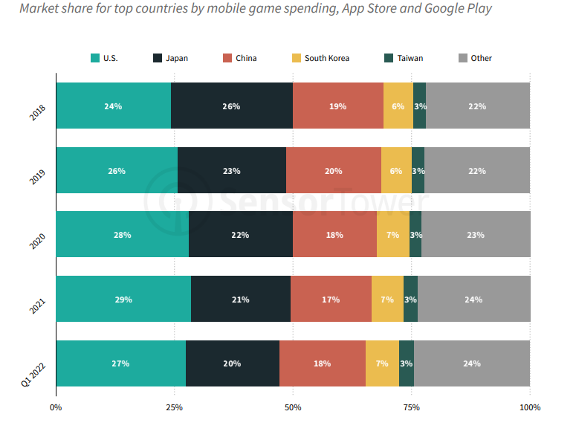
Mobile Game Revenue
Consumer Spending Worldwide
OVERVIEW
Mobile game revenue declined Y/Y for the first time in history during Q1 2022. Player spending declined 6 percent Y/Y to $21.2 billion.
The two largest markets by spending (U.S. and Japan) experienced double digit revenue decline during Q1 2022, losing a combined 3 percent market share of global mobile game revenue compared to 2021.
Countries outside the top five have slowly gained market share, suggesting that mobile game publishers have turned to less-tapped markets with higher growth potential.
Taiwan displaced Germany as the fifth largest mobile games market in the world. Consumer spending in this country was close to $700 million in Q1 2022.
Each of the five top countries by player spending growth are in Asia, exposing how relevant the APAC region is for the games industry.

Slide 11
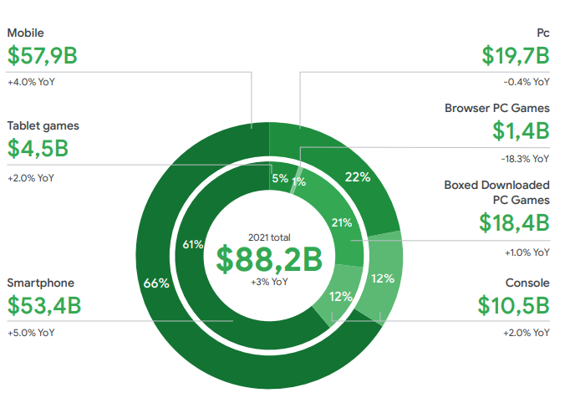
Mobile Game Revenue - APAC
Rising technological literacy, affordable smartphones, and improvements to internet infrastructure are driving audience and consumer spending growth in multiple markets in Southeast Asia and India.
Asia-Pacific is home to three of the top four gaming markets by consumer spending, and 55% of players worldwide, who together represent a combined 49% of global consumer spending on games.
Asia-Pacific is a predominantly mobile-first market. The $57.9 billion spend on mobile games represents a striking two-thirds of the region’s total consumer spending.
For the most part, console gaming isn’t as popular in Asia-Pacific. Largely driven by the Japanese market and Oceania, Asia-Pacific’s 249.6 million console players was expected to spend a combined $10.5 billion in 2021.
While PC gamers have been switching to mobile for the past decade, there’s still a sizable PC gaming
market in Asia-Pacific, largely due to the popularity of PC gaming cafés in mainland China
and South Korea, where they are known as PC bangs.

Slide 12
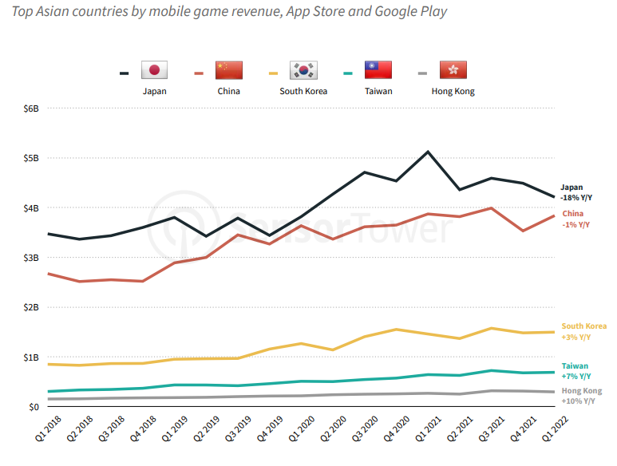
Mobile Game Revenue - APAC
Consumer Spending in Asia-Pacific
OVERVIEW
During Q1 2022, revenue decreased by 7 percent Y/Y to $11.2 billion.
The revenue decline was more pronounced on Google Play (13%) compared to the App Store, which decreased by 4% Y/Y during Q1 2022.
Following the same trend observed in the U.S. market, mobile game revenue in Asia declined during Q1 2022. Still, it remains by far the most lucrative region for mobile game revenue, led by China and Japan.
India, the largest mobile games market in the world by downloads, started to catch up in consumer spending. During Q4 2021, spending increased 96% Y/Y, followed by a very strong Q1 2022, with revenue up 73%.
Japan’s mobile game revenue decreased by more than $900 million in Q1 2022 vs. Q1 2021, a reduction of 18 percent.
Thailand also showed weak performance, with revenue decreasing 31 percent year-over-year to $65 million.
Taiwan was the No. 1 country in Asia by growth, with consumer spending up nearly 7 percent Y/Y to more than $690 million.
Revenue figures are gross revenue (including the cut taken by Apple or Google). China numbers only include the App Store as Google Play is not available there. (*)

Slide 13
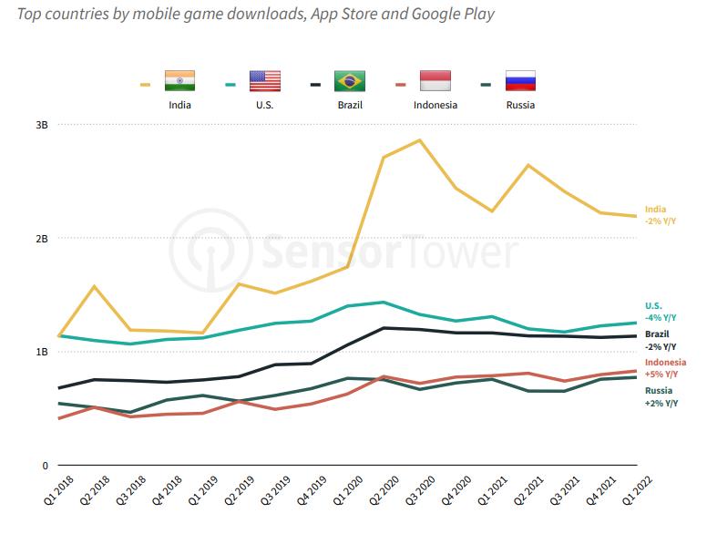
Mobile Game Adoption
Mobile Game Downloads Worldwide
OVERVIEW
Mobile game downloads experienced big gains starting in Q1 2020, right at the beginning of the pandemic.
Although mobile game adoption has slowed since its peak in Q2 2020, it has remained well above pre-pandemic levels.
As smartphone penetration in India increased in recent years, it has become the largest market for mobile game downloads, accumulating 15% of the worldwide total in Q1-2022.
COVID-19 boosted game adoption in the Indian market by 65% during 2020. After that increased penetration, the market has cooled down and has been decreasing since Q2 2021.
Indonesia and Russia are the only top countries that continued to show growth during Q1 2022.
Vietnam, Philippines, Thailand, Pakistan, and Kazakhstan were the only countries to achieve double-digit Y/Y growth during Q1 2022. These five markets combined are now larger than the overall U.S. market.

Slide 14
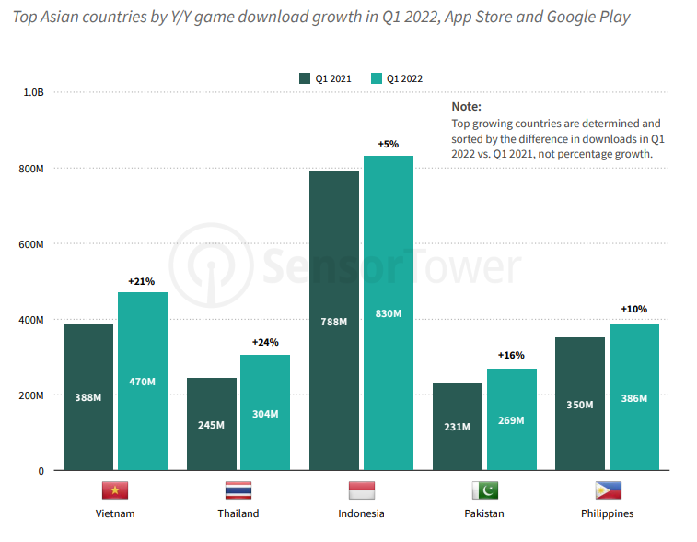
Mobile Game Adoption
Mobile Game Downloads APAC
OVERVIEW
Quarterly mobile game downloads in Asia surpassed 6 billion for the first time in Q2 2020 during the pandemic. Although installs have dropped off from this peak, they still surpassed 5.8 billion during Q1 2022, up 4% year-over-year.
The vast majority of game installs in Asia came from Google Play, driven largely by countries like India and Indonesia where Android phones are much more popular than iPhones.
About 87% of downloads in Q1 2022 were from Google Play, up from 71% in Q1 2018.
Vietnam saw the largest download growth in APAC region during Q1 2022, with installs increasing more than 80 million, up 21% year-over-year.
Thailand also experienced high download growth during the quarter, as installs rose by nearly 60 million, up 24 percent Y/Y.
Indonesia and the Philippines also experienced growth during the quarter, with downloads increasing by 5 percent and 12 percent, respectively.
India is the largest mobile games market by downloads in the world. During the last quarter, Indian game downloads were down 2 percent year-over-year to 2.2 billion.

Slide 15
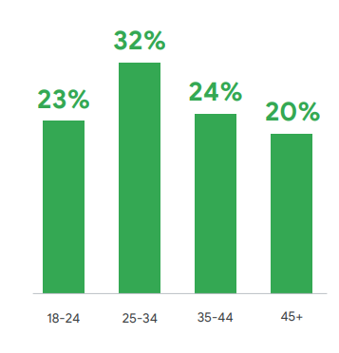
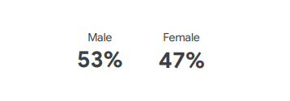
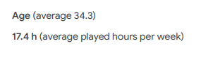
Addressable Market
APAC Snapshot – Focus on China, South Korea, Japan, Vietnam, India and Taiwan
Taken as a whole, the demographics of players from our selected Asia-Pacific markets are similar to those from other regions.
The average age of 34.3 is slightly younger than other regions. This minor difference is driven by the younger gaming population in growth markets like Vietnam and India, where older generations didn’t grow up with gaming as generations have in more mature markets.
One important note is that players in Asia-Pacific have the highest weekly average play time of all regions, at 17.4 hours per week.
Players from Vietnam, China, and India were already very positive about their gaming activity and tend to be bullish about their future activity as well.
Players from Japan, South Korea, and Taiwan, on the other hand, tend to be more conservative about their present and future play time.
Returning players (those who resumed playing between February 2020 and May 2021 after having stopped) rate the importance of video games consistently lower in the future. For these players, it’s likely that the lack of entertainment options during COVID-19 lockdowns reignited an interest in gaming, but they aren't as dedicated as veteran and new players.
APAC gamer demographics

Slide 16
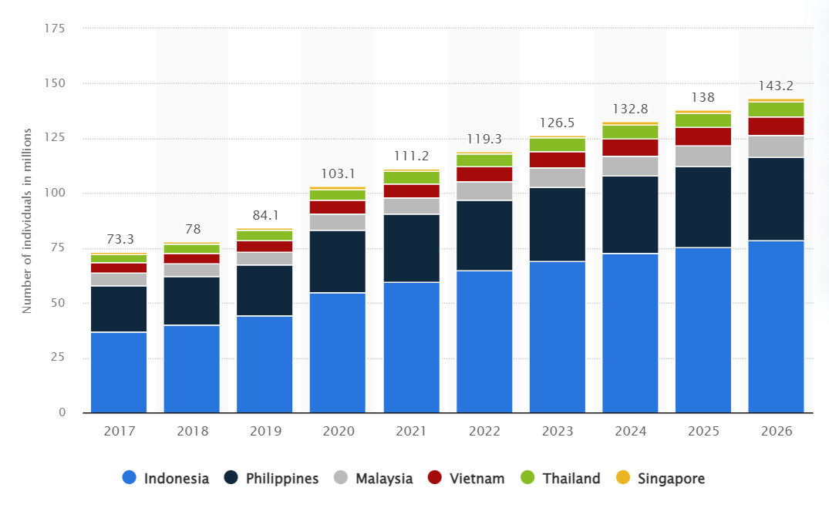
Addressable Market
Number of mobile gamers in Southeast Asia from 2017 to 2026, by country (in millions)
(*) Source: Statista, 2022

Slide 17
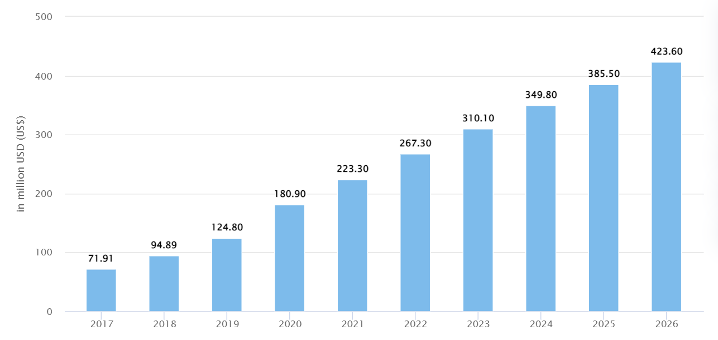
Addressable Market - Vietnam
Vietnam Mobile Game Market Snapshot
OVERVIEW
Revenue in the Mobile Games segment is projected to reach US$267.30m in 2022.
Revenue is expected to show an annual growth rate (CAGR 2022-2026) of 12.20%, resulting in a projected market volume of US$423.60m by 2026.
In the Mobile Games segment, the number of users is expected to amount to 8.5m users by 2026.
User penetration will be 7.1% in 2022 and is expected to hit 8.3% by 2026.
In global comparison, most revenue will be generated in China (US$47,130.00m in 2022).
The average revenue per user (ARPU) in the Mobile Games segment is projected to amount to US$37.83 in 2022.
In the year 2021 a share of 41.7% of users is in the high-income group.
(*) Source: Statista, 2022

Slide 18
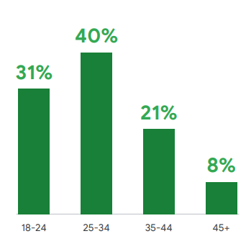
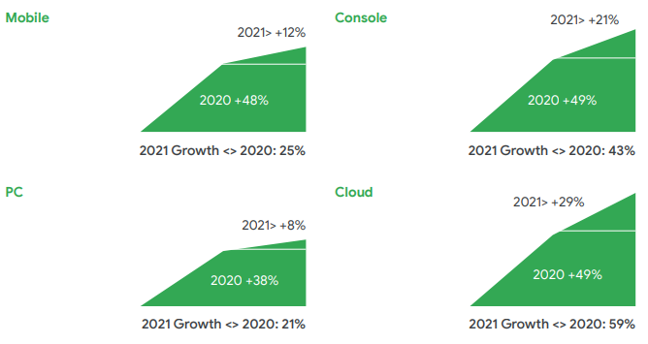
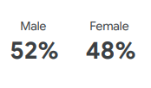
Addressable Market - Vietnam
The majority of gamers are aged 19-35, signaling branding opportunities among young professionals
DEMOGRAPHICS & TECH TRENDS
The average age of gamers is 30.1 years old, with just over 70% falling into the 18-35 group, making the country a viable choice for brands looking to target young professionals.
However, the country also has the lowest share of gamers over the age of 45 (just 8%), meaning there are fewer opportunities among older groups.
PC’s growth is slower than other segments. One possibility here is that some PC engagement growth was offset by the closure of cybercafes (which some PC gamers in Vietnam frequented).
Age & Gender
Charts show players who report/expect to play more MINUS players who report/expect to play less in 2020-2021

Slide 19
Addressable Market - Thailand
Thailand Mobile Game Market Snapshot
OVERVIEW
Revenue in the Mobile Games segment is projected to reach US$380.90m in 2022.
Revenue is expected to show an annual growth rate (CAGR 2022-2026) of 11.02%, resulting in a projected market volume of US$578.60m by 2026.
In the Mobile Games segment, the number of users is expected to amount to 6.8m users by 2026.
User penetration will be 8.2% in 2022 and is expected to hit 9.7% by 2026.
In global comparison, most revenue will be generated in China (US$47,130.00m in 2022).
The average revenue per user (ARPU) in the Mobile Games segment is projected to amount to US$66.46 in 2022.
In the year 2021 a share of 44.4% of users is in the high-income group.
DEMOGRAPHICS
In 2021, 76.5 percent of casual online gamers in Thailand were between 18 to 24 years old. In comparison, only 1.1% of gamers in the segment were 55 years and older.
TECH & GAME GENRE TRENDS
According to a survey by Rakuten Insight in March 2020, 83% of female Thai respondents stated that they used mobile phones to play online games. Role-playing games were also discovered to be the mot popular online games genre.
(*) Sources: Statista, 2022 | Statista, 2020 | Statista, 2021

Slide 20
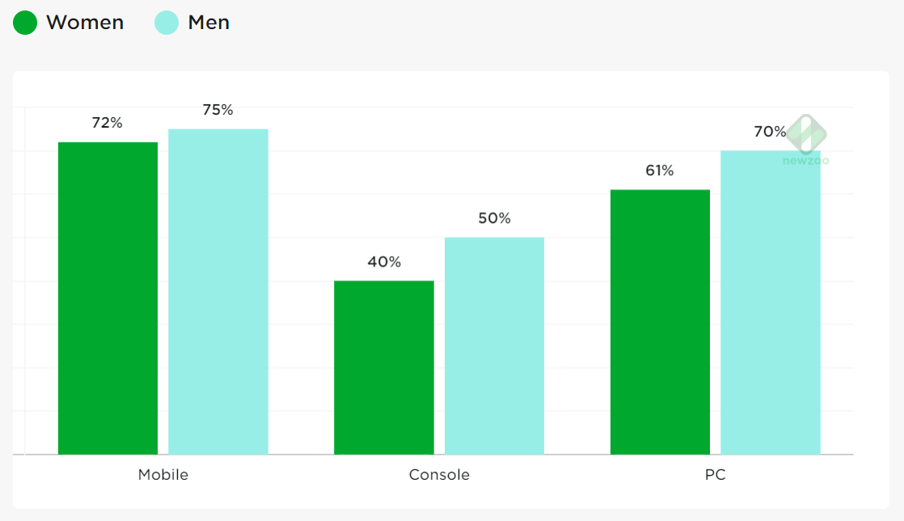
Addressable Market – The Philippines
The Philippines Mobile Game Market Snapshot
OVERVIEW
Revenue in the Mobile Games segment is projected to reach US$1.17bn in 2022.
Revenue is expected to show an annual growth rate (CAGR 2022-2026) of 6.90%, resulting in a projected market volume of US$1.53bn by 2026.
In the Mobile Games segment, the number of users is expected to amount to 38.1m users by 2026.
User penetration will be 28.8% in 2022 and is expected to hit 32.2% by 2026.
In global comparison, most revenue will be generated in China (US$47,130.00m in 2022).
The average revenue per user (ARPU) in the Mobile Games segment is projected to amount to US$36.04 in 2022.
(*) Sources: Statista, 2022
GAME GENRE TRENDS
Strategy is the most popular genre on mobile, social network sites, and PC.
Given the widespread popularity of puzzle and strategy games among mobile gamers in this mobile-first market, more than half of the Philippines’ urban online population played Candy Crush Saga.
TECH TRENDS
For the majority of gamers in the Philippines, mobile is the platform of choice. Nevertheless, PC games and console games are also popular.

Slide 21
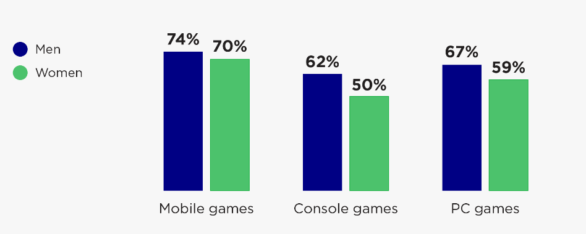
Addressable Market - Indonesia
Indonesia Mobile Game Market Snapshot
OVERVIEW
Revenue in the Mobile Games segment is projected to reach US$1.58bn in 2022.
Revenue is expected to show an annual growth rate (CAGR 2022-2026) of 6.89%, resulting in a projected market volume of US$2.06bn by 2026.
In the Mobile Games segment, the number of users is expected to amount to 78.6m users by 2026.
User penetration will be 23.2% in 2022 and is expected to hit 27.1% by 2026.
In global comparison, most revenue will be generated in China (US$47,130.00m in 2022).
The average revenue per user (ARPU) in the Mobile Games segment is projected to amount to US$24.42 in 2022.
In the year 2021 a share of 46.9% of users is in the high-income group.
(*) Sources: Statista, 2022
GAME GENRE TRENDS
Strategy is the top genre on mobile, while battle royale and MOBA is top on console and PC, respectively.
TECH TRENDS
74% of men and 70% of women play mobile games, while 62% of men and 50% of women play console games.

Slide 22
Agenda
Introduction
Executive Summary
Assumptions & Key Findings
Market Overview
Market Trends
Competition

Slide 23
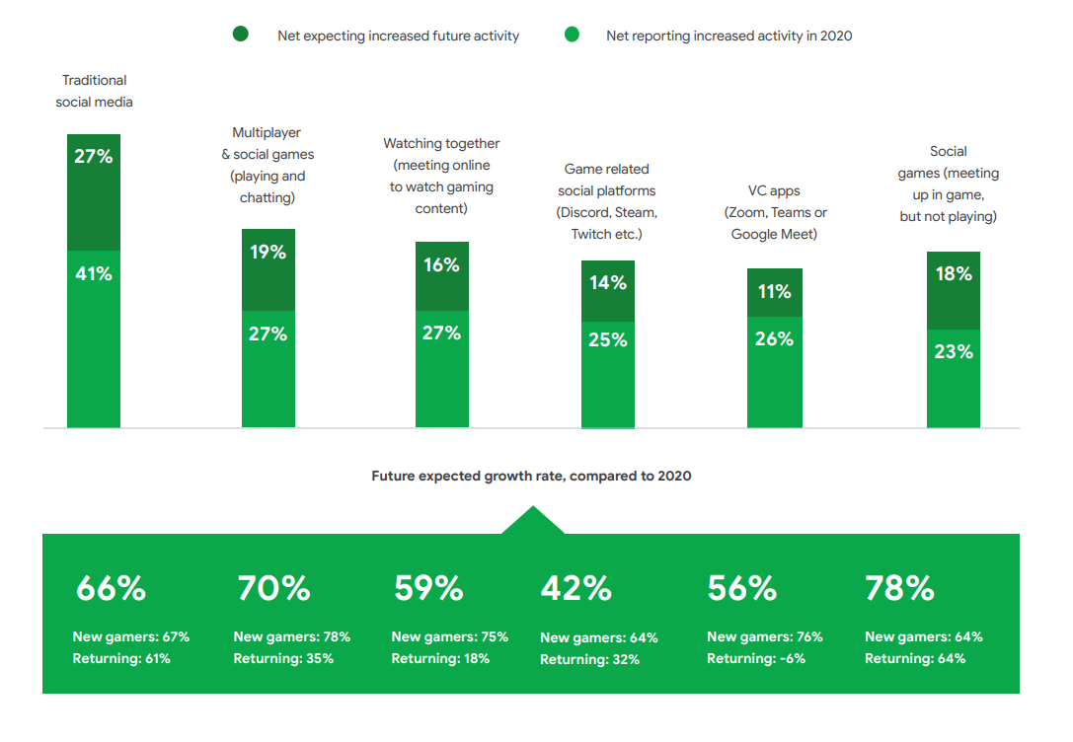
Technology Trends in APAC
Gaming technology is promoting social engagement
Reported usage and expected future usage of social platforms in selected Asia-Pacific markets
New players tend to say they’re more likely to continue using all social platforms in the future, apart from meeting up to hang out in game worlds
Returning players’ interest in game-world hangouts is high and it matches new players’ interest.

Slide 24
Technology Trends in APAC
The Western trend of the emerging metaverse evolves in Asia-Pacific markets; this movement towards the idea of the metaverse will evolve differently in each constituent market
China, Taiwan, India, and Vietnam are all seeing growing appetites among players to use games to socialize and share digital, metaverse-like experiences.
There’s a strong appetite for metaverse-like experience in most of the focused APAC markets;
We expect strong growth for social gaming, including meeting up in game worlds, chatting and socializing while playing multiplayer and social games, and watching gaming content in groups.
Although Japan and South Korean respondents expect their personal use of social platforms to decrease in the future, virtual non-gaming experiences may be different because of their ability to let users engage with influencers.
There’s a significant market for virtual idols in Japan, which comes with its own unique collaboration opportunities. VTubers, for example — virtual avatars that replace real-life streamers and influencers — are already a popular group streaming Apex Legends.

Slide 25
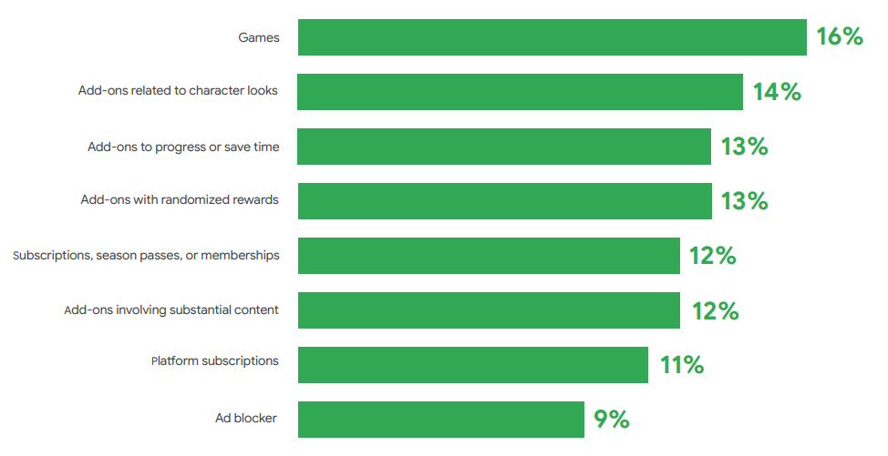
Technology Trends in APAC
Asia-Pacific will continue to be a mobile-first gaming region
SUMMARY
Across all Asia-Pacific markets, 97% of all players play on mobile.
88% of gamers in the markets play on mobile the most.
Consumers in Asia-Pacific spend 66% of their total gaming budget on mobile games.
This growth is particularly strong in India, China, and Vietnam.
Asia-Pacific’s mobile players spend their budget on a much wider range of items than do players in other regions.
India, China & Vietnam: Players tend to expect spend to increase everywhere, often by quite a lot (+27% avg. net number of players across all categories*)
Japan, South Korea & Taiwan: Players indicate moderate change in spending (+5% avg. net across all categories)
Share of mobile budget spend by category

Slide 26
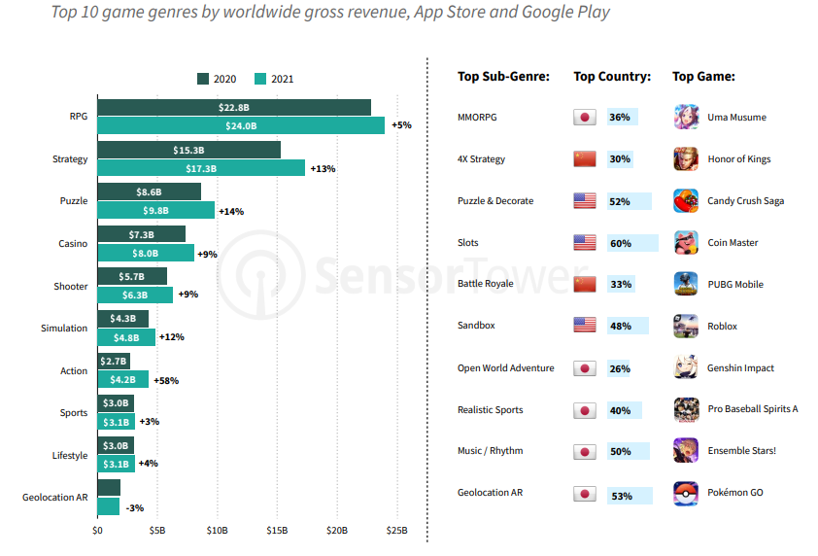
Game Genre Trends Worldwide
Top Game Genre by Revenue in 2021
OVERVIEW
RPG led all genres by revenue in 2021, followed by Strategy and Puzzle.
Strategy revenue grew by $2B year-over-year, while RPG was close behind with growth of $1.2B, followed by Puzzle with an increase of $1.1B
The No. 2 fastest growing genre was Puzzle with 14%, with Strategy ranking No. 3 at 13% Y/Y.
Note: Revenue figures are gross revenue (including the cut taken by Apple or Google).

Slide 27
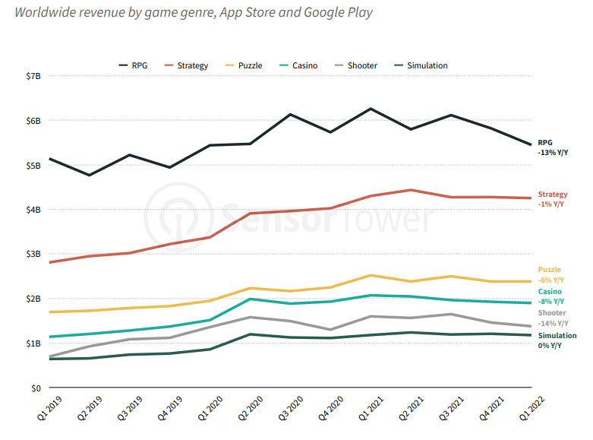
Game Genre Trends Worldwide
Most Top Genres Saw Revenue Decline in Q1 2022
OVERVIEW
RPG, the largest genre by worldwide revenue, experienced a double-digit decline, with spend decreasing by 13% year-over-year.
The five largest game genres registered revenue declines during Q1 2022.
Strategy had the least drastic decrease. During Q1 2022, Strategy games generated $4.2 billion worldwide, down 1 percent Y/Y.
Note: Revenue figures are gross revenue (including the cut taken by Apple or Google).

Slide 28
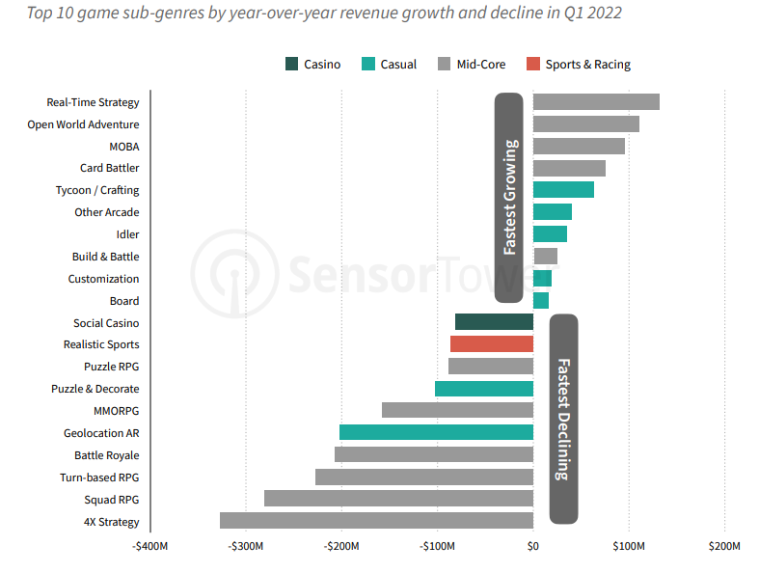
Game Genre Trends Worldwide
Real-Time Strategy is the Fastest Growing Sub-Genre by Revenue Growth
OVERVIEW
Real-Time Strategy was the fastest growing subgenre during Q1 2022, with revenue increasing by more than $130 million, mainly due to the excellent performance of Clash Royale from Supercell.
On the other hand, 4X Strategy was the fastest declining sub-genre in Q1 2022. Rise of Kingdoms (revenue down 27% Y/Y) and State of Survival (down 28% Y/Y) contributed to this decrease.
Note: Revenue figures are gross revenue (including the cut taken by Apple or Google).

Slide 29
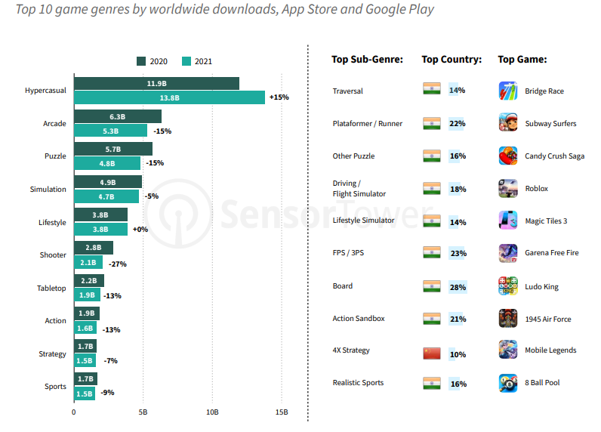
Game Genre Trends Worldwide
Top Game Genres by Downloads in 2021
OVERVIEW
Hypercasual install growth continued in 2021, rising 15% year-over-year. Hypercasual games were downloaded nearly 14 billion times last year.
While Hypercasual continued to grow in 2021, all other game genres exhibited negative growth, including Puzzle with a decline of 15% Y/Y.

Slide 30
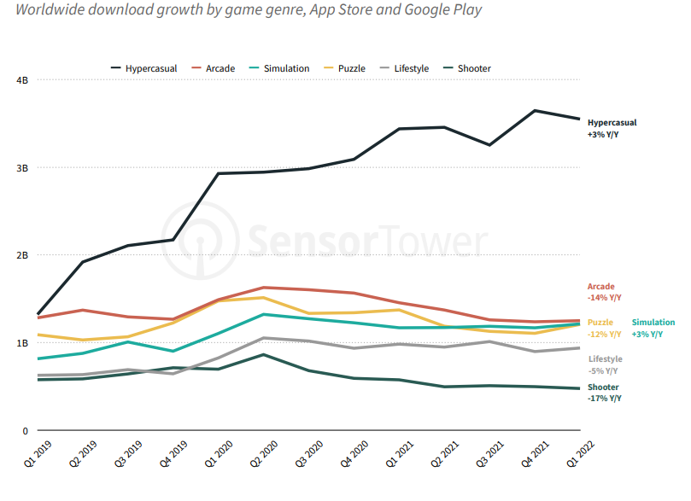
Game Genre Trends Worldwide
Puzzle has seen double digit decline in download growth Y/Y
OVERVIEW
Puzzle, Arcade, and Shooter saw double-digit declines in Q1 2022.
Hypercasual has seen staggering growth since 2018. Hypercasual installs have climbed from 757 million in Q1 2018 to more than 3.5 billion in Q1 2022.

Slide 31
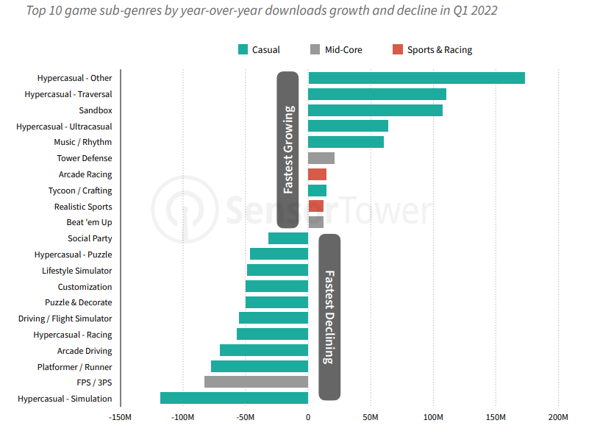
Game Genre Trends Worldwide
Hypercasual Sub-Genres Drive Adoption Growth in Q1 2022
OVERVIEW
Five of the top 10 fastest growing sub-genres by year-over-year growth in Q1 2022 were in the Hypercasual genre, including the top two.

Slide 32
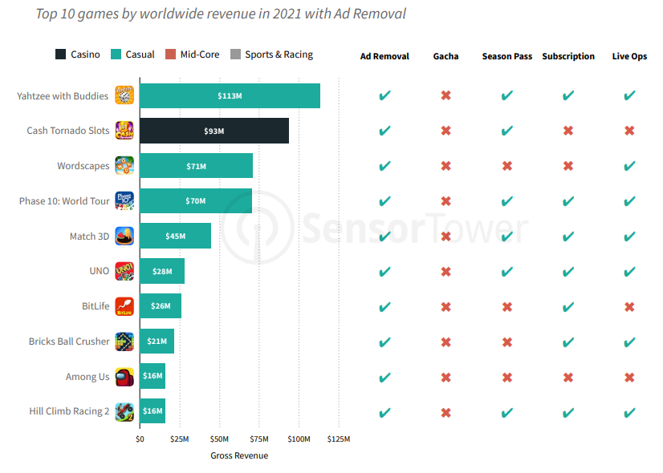
Monetization Trends
Ads Removal
Casino game Cash Tornado Slots from AppLovin stands out as the only non-casual title in the top 10 grossing rankings that features an Ad Removal option.
This demonstrates the publisher’s expertise in the mobile advertising space, where it operates its own ad network.

Slide 33
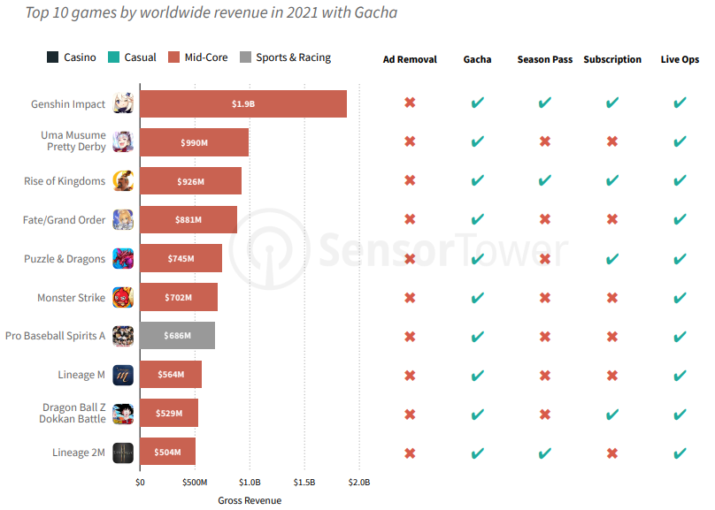
Monetization Trends
Gacha
Gacha is most commonly utilized in the MidCore market, with titles in the class accounting for nine of the top 10 revenue generating games that feature Gacha monetization.

Slide 34
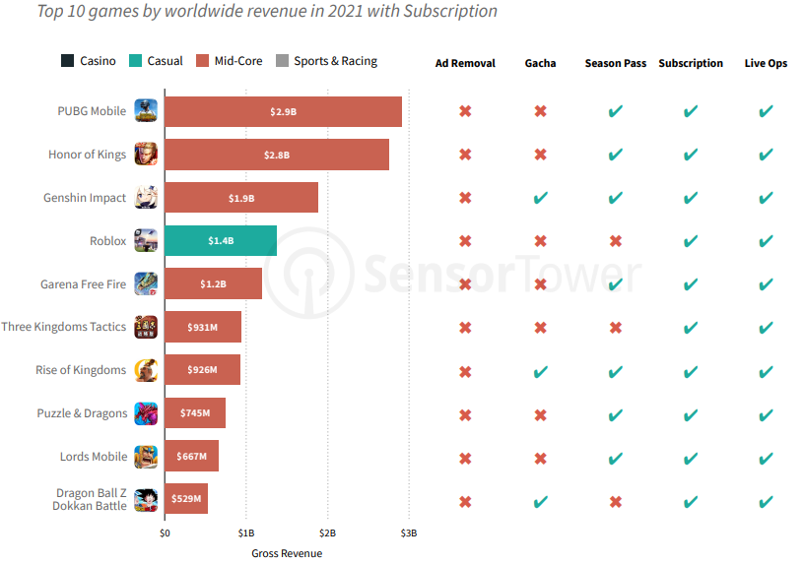
Monetization Trends
Subscription
Roblox stands out as one of the only top grossing mobile titles that implements a Subscription without a Season Pass.
One of the key foundations for a Subscription model to work is the constant stream of new content to avoid churn, often provided by Live Ops.
In the case of Roblox, the subscription provides a regular, set amount of in-game currency, Robux, that can be used on the title’s wide variety of user-generated content.

Slide 35
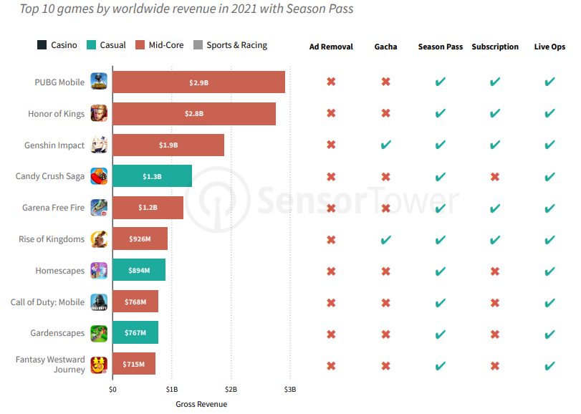
Monetization Trends
Season Pass
While the majority of the top titles that have implemented a Season Pass are Mid-Core games, Casual titles have also started to add the feature.
Examples include Candy Crush Saga from King along with Homescapes and Gardenscapes from Playrix.

Slide 36
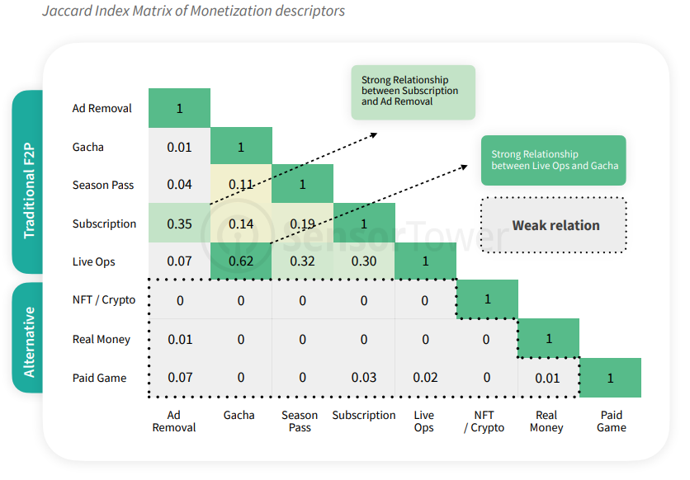
Monetization Trends
Monetization Strategies Relationships: Traditional F2P vs Alternative Methods
OVERVIEW
Data reveals a strong association between Live Ops and Gacha. This is likely due to titles with Gacha mechanics requiring regular updates to keep users engaged with new and existing content.
Subscriptions and Ad Removal also show a strong association, as these monetization methods are both most popular with Casual titles, which also have a higher probability of utilizing in-game ads.
While traditional free-to-play mechanics are intertwined, emerging and alternative monetization method such as NFT/Crypto typically show no relationship with other features.

Slide 37
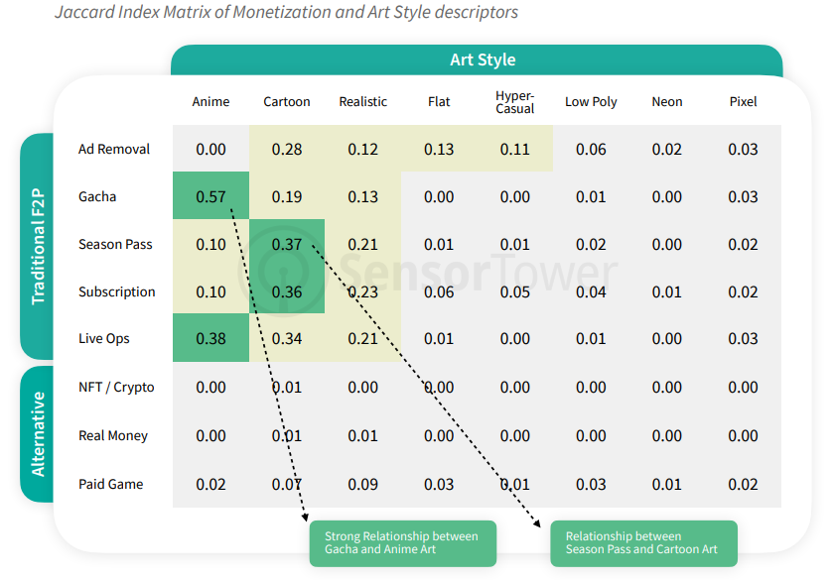
Monetization Trends
Monetization Strategies Relationships: Traditional F2P vs Alternative Methods
OVERVIEW
Data reveals a strong association with games that feature Gacha features and the Anime art style, which is also hugely popular in Japan.
The Cartoon art style shows a strong relationship with the Season Pass and Subscription monetization descriptors.
A weak relationship between Cartoon art style and NFT/Crypto monetization strategy is also detected.

Slide 38
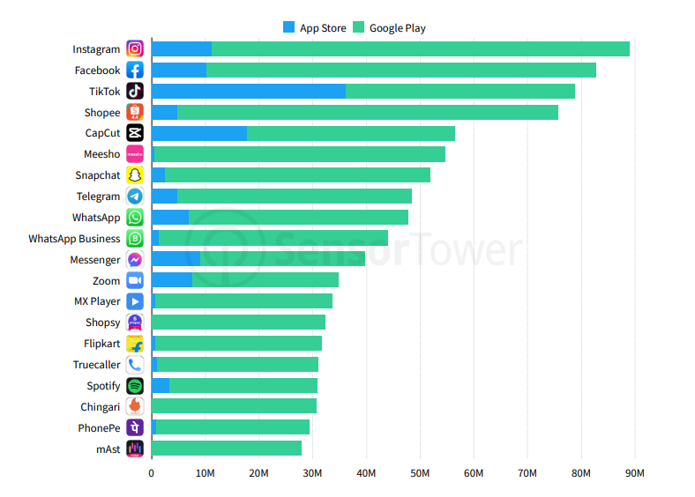
Top Apps & Games
Top Apps by Asia Downloads in Q1 2022
APP STORE vs GOOGLE PLAY
Instagram was the top app for third straight quarter in Q1 2022, followed by another Meta-owned app, Facebook.
TikTok, the top in the U.S. and Europe, ranked No. 3 in Asia.

Slide 39
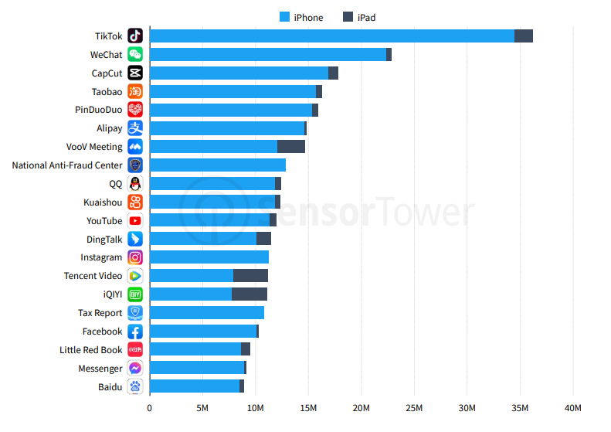
Top Apps & Games
Top Apps by Asia Downloads in Q1 2022
IPHONE vs IPAD
ByteDance had two of the top three apps in Asia on the App Store in Q1 2022.
As China imposed lockdowns against a surge in COVID-19, VooV Meeting’s downloads climbed 126% quarter-over-quarter to more than 14.6 million.

Slide 40
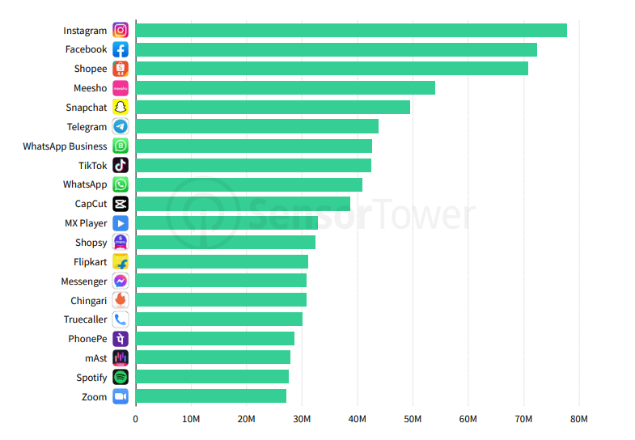
Top Apps & Games
Top Apps by Asia Downloads in Q1 2022
GOOGLE PLAY
Instagram was the top Google Play app in Asia just ahead of Facebook and Shopee.
The Shopping category continued its rapid ascent on Google Play in Asia with installs up 63% year-over-year.

Slide 41
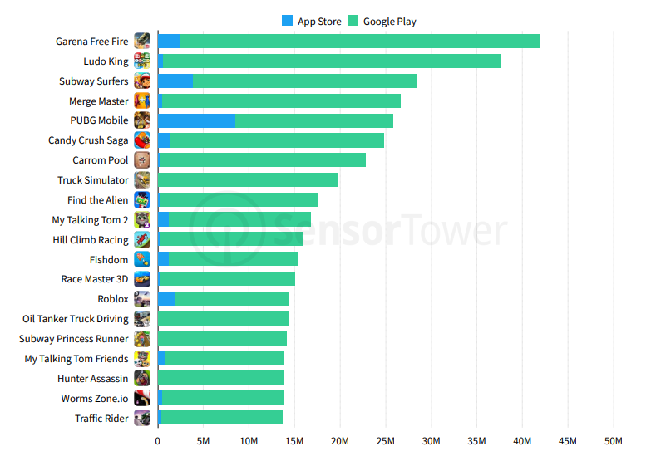
Top Apps & Games
Top Games by Asia Downloads in Q1 2022
APP STORE vs GOOGLE PLAY
The top three games in Asia in Q1 2022 were the same as the previous quarter, with Garena Free Fire leading Ludo King and Subway Surfers.
PUBG Mobile returned to the top five in Asia.

Slide 42
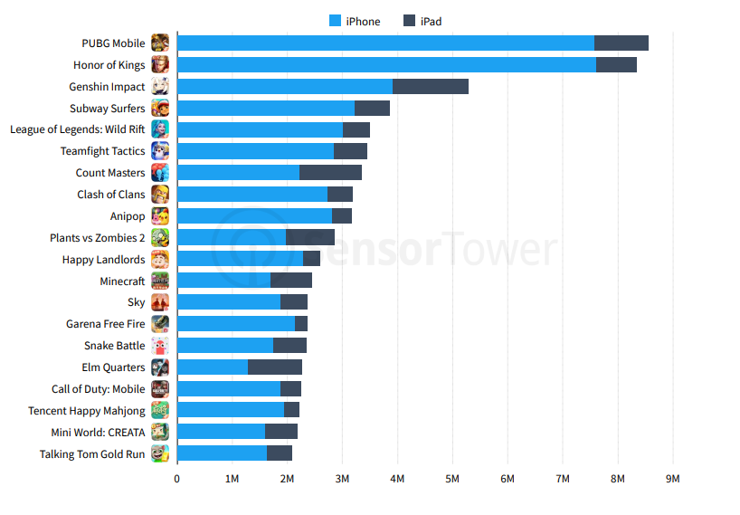
Top Apps & Games
Top Games by Asia Downloads in Q1 2022
IPHONE vs IPAD
PUBG Mobile from Tencent took the top spot on the App Store with 37 percent quarter-over-quarter growth.
League of Legends: Wild Rift, also from Tencent, followed up its huge launch in China last quarter with a return to the top five games

Slide 43
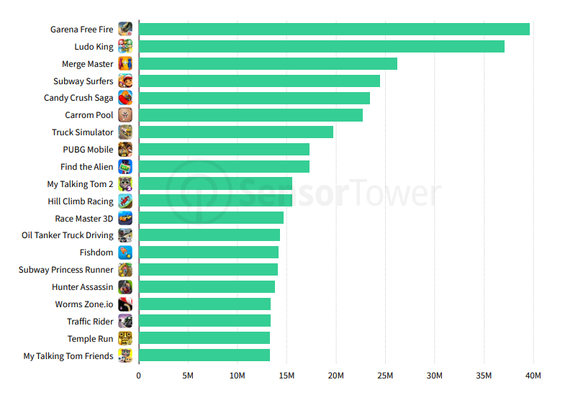
Top Apps & Games
Top Games by Asia Downloads in Q1 2022
GOOGLE PLAY
Garena Free Fire was the top game on Google Play for the second straight quarter, boosted by its release of Garena Free Fire MAX.
Candy Crush Saga also had a strong quarter in Asia ranking at No. 5.

Slide 44
Agenda
Introduction
Executive Summary
Assumptions & Key Findings
Market Overview
Market Trends
Competition

Slide 45

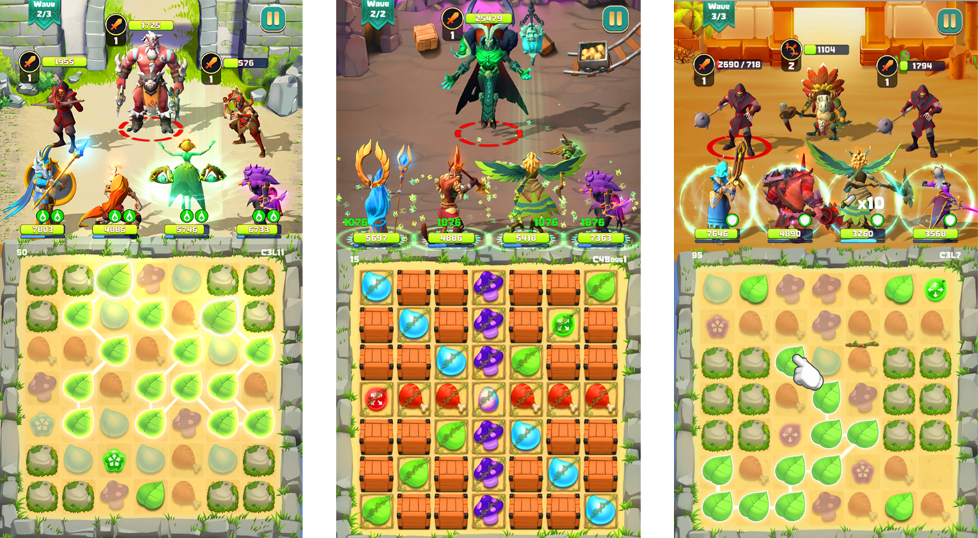
Competition - HeroVerse
Match-three (Puzzle) NFT Games
1/ HeroVerse
HeroVerse is the first Match-Three Puzzle and RPG Strategy NFT Game built on BNB Chain.
Value proposition:
Play & Earn (instead of P2E)
Boosts hero’s strength by crypto price movement
Two types of token: pre-minted token and unlimited token
Earn mechanism:
Trading: Players can sell Heroes and valuable items at the Marketplace
Renting: Players can rent out their hero for profit. The rental price will depend on the hero's value in the market
Gacha: Lucky spin function, players will be profitable if they are lucky enough to open valuable rare heroes
Supported device:
iOS, Android, Windows
Game release:
November 2021

Slide 46

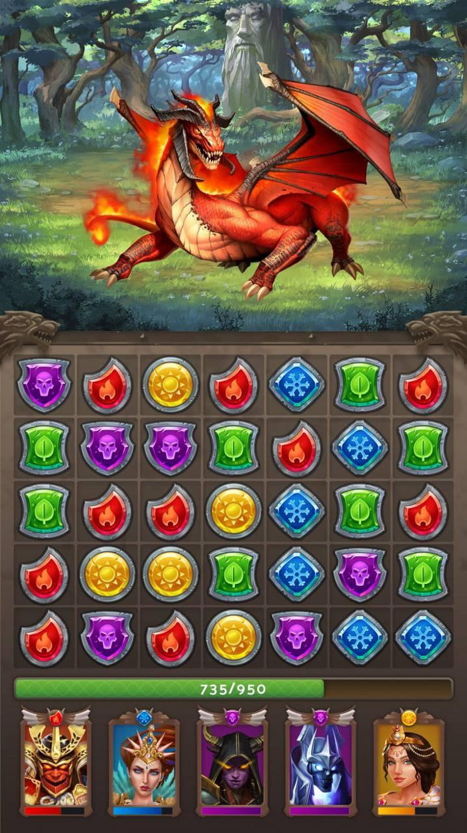
Competition – Puzzle Royale
Match-three (Puzzle) NFT Games
2/ Puzzle Royale
Puzzle Royale (PR) is a match 3 game built on BNB Chain, focusing on RPG elements and competitive gameplay.
Value proposition:
Play-to-Earn
Every Hero in the game will be a non-fungible token (NFT). These Heroes can be fused to create new ones or be traded on the marketplace.
PVE or PVP modes
Earn mechanism:
The player will perform daily tasks to level up their battle pass and participate in activities involving other players to earn Puzzle Royale Coins ($PUZZ).
Players will be rewarded with $PUZZ and experience to upgrade their Hero when they complete levels in the campaign mode.
PvP is the primary way for the players to earn $ROYAL in the game, with the highest ranked players being able to earn $ROYAL.
Supported device:
iOS & Android
Game release:
Q2-2022

Slide 47

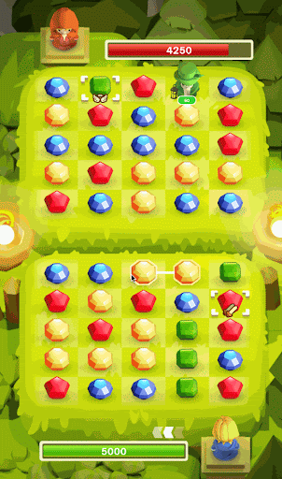
Competition – Himo World
Match-three (Puzzle) NFT Games
3/ Himo World
Himo World is a match-3 deck building NFT strategic puzzle game built on BNB Chain.
Value proposition:
Free-to-Play (F2P), Create-to-Earn (C2E) & Compete-to-Earn
Rogue-like PvE & PvP with multi-tier Tournaments.
Earn mechanism:
HIMO holders can earn HIMO tokens through playing games, participating in events and key governance votes.
Players can also earn HIMO tokens by participating in-game activities.
Supported device:
iOS, Android (and web in the future)
Game release:
March 2022

Slide 48

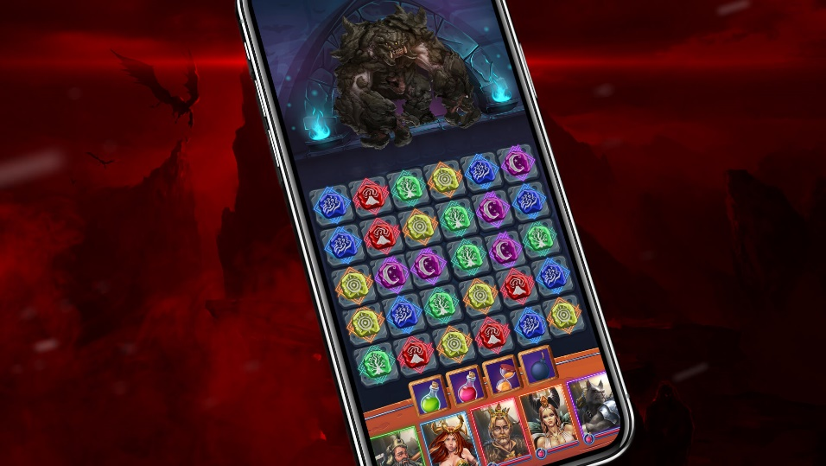
Competition – Puzzle Crusade
Match-three (Puzzle) NFT Games
4/ Puzzle Crusade
Puzzles Crusade is a Match 3 RPG built on Solana Blockchain. The game features an interactive economic and strategic Metaverse created to explore and conquer the in-game world.
Value proposition:
Play-to-Earn
Play with NFTs in the actual game
Establish an emotional connection by consistently intriguing and rewarding, all the way through the player’s journey inside the game
Ownership is a vital aspect of the Puzzles Crusade. If you don’t own your collection, the entire universe of value falls apart
Earning mechanism:
By having, earning, and exchanging unique, rare, stunning, and in-game useful NFTs, players will not only enjoy the game but will keep the interest to grow and expand in order to convert the value and reward themselves in real life.
Supported device:
iOS, Android
Game release:
Q4-2022

Slide 49

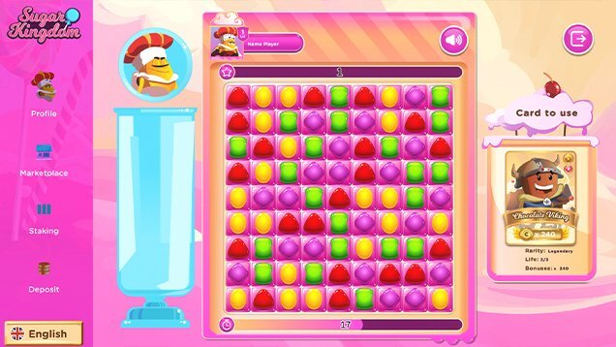
Competition – Sugar Kingdom
Match-three (Puzzle) NFT Games
5/ Sugar Kingdom
Sugar Kingdom is a Match 3 built on Binance Smart Chain.
Value proposition:
Play-to-Earn
PvE, PvP, PvP with bet
Metaverse features
Safe investment within the economy
Great incentives and rewards scheme for the time and the money invested by the user.
Earn mechanism:
VIP staking: lock CANDY to earn more CANDY
Sweet staking: stake CANDY to earn CHOCOLATE as a rewards
Royalty staking: stake CANDY tokens for a certain time to earn royalty points, becoming the Royalty of the Kingdom
My profile: claiming rewards with levels and Royalty Points
Supported device:
unknown
Game release:
unknown

Slide 50

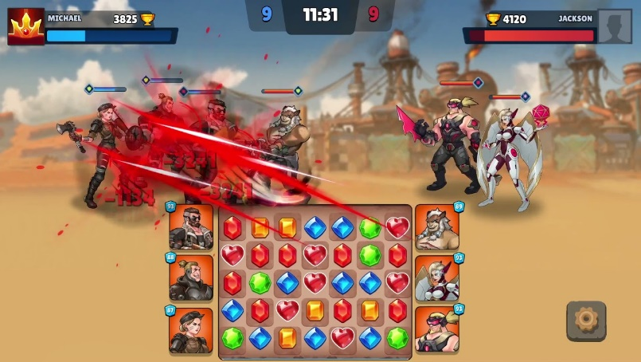
Competition – Wasted Lands
Match-three (Puzzle) NFT Games
6/ The Wasted Lands
Wasted Lands is a puzzle-RPG-strategy mashup.
Value proposition:
PvE, PvP
Free-to-Play and Play-to-Earn
Earn mechanism:
Mint, trade & rent warriors NFT
Periodical tournaments and events
Earn $WAS token through PvE & PvP mode. Selling rewards & earning resources on marketplace
Staking $WAL tokens or NFTs to earn fixed APR
Supported device:
Mobile & PC in April 2022
Game release:
MVP in January 2022

Slide 51
Thank You!
Contact
Kimmy Le | Kimmy@rfox.com

